Slide 1

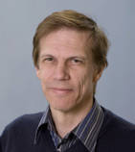
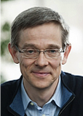
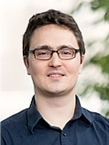


Disentangled Person Image Generation
Liqian Ma¹ Qianru Sun^{2*} Stamatios Georgoulis¹ Luc Van Gool^{1,3} Bernt Schiele² Mario Fritz² ¹KU Leuven ²MPI for Informatics ³ETH Zürich *Corresponding author
Paper ID: 1801 Project page: https://homes.esat.kuleuven.be/~liqianma/CVPR18_DPIG/
Liqian¹
Qianru²
Stamatios¹
Luc^{1,3}
Bernt²
Mario²
¹KU Leuven ²MPI for Informatics ³ETH Zürich
Notes:
Hello everyone. My name is Liqian. Our paper is “Disentangled Person Image Generation”

Slide 2
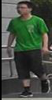
Problem statement
-- Disentangled Person Image Generation
Task: Synthesize person images, while independently controlling foreground, background, and pose, in a self-supervised way.
Motivation: Give users more control over person image manipulation and sampling.
Key idea: Disentangle person images into the aforementioned components, and then combine.
Foreground
Fusion
Background
Pose
Notes:
Our task is to synthesize natural person images, while independently control three weekly related factors, foreground, background, and pose. And it is done with a self-supervised way, which means we do not need paired training data.
Our motivation is to give users more control over image manipulation and sampling. The main idea is to disentangle the image into foreground, background, pose, and then combine them together.

Slide 3
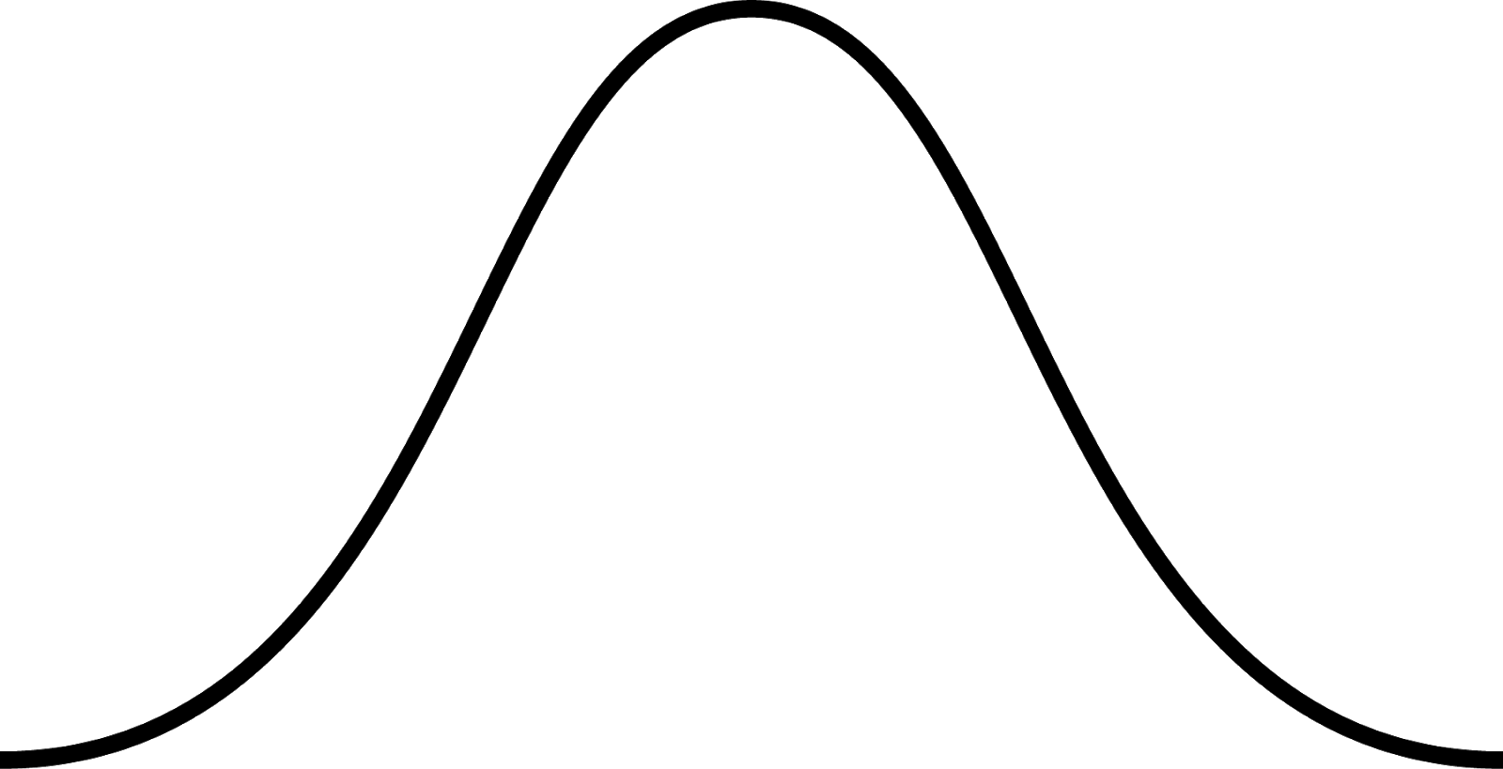
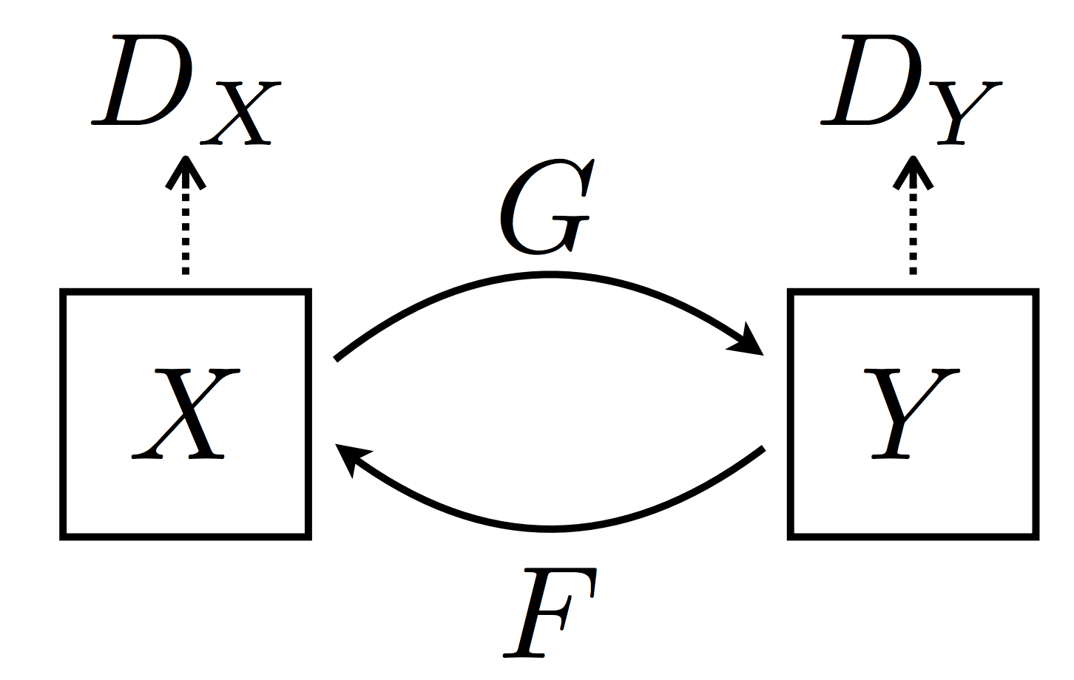
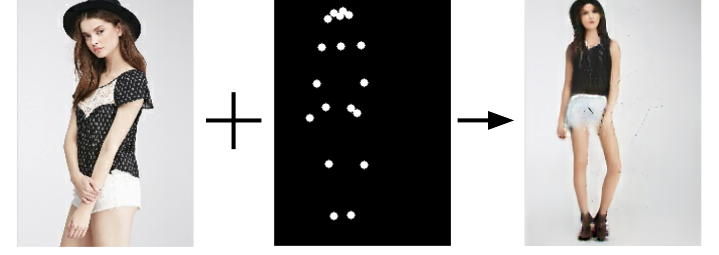
Related work
-- Disentangled Person Image Generation
E
G
G
D
noise z
noise z
VAE [1]
DCGAN [2]
Condition image
Target pose
Generated image
PG² [3]
CycleGAN [4]
[1] D. P. Kingma and M. Welling. Auto-encoding variational bayes. In ICLR, 2014.
[2] I. J. Goodfellow et al. Generative Adversarial Nets. In NIPS, 2014.
[3] L. Ma et al. Pose guided person image generation. In NIPS, 2017.
[4] J.-Y. Zhu et al. Unpaired imageto-image translation using cycle-consistent adversarial networks. In ICCV, 2017
Notes:
The previous methods do not provide the control over the generation process such as DCGAN/VAE/CycleGAN. Or need the paired data for training like PG2.
DCGAN and VAE can directly be used to generate person images in an unsupervised way. But the generated images are not good enough due to the lack of structure guidance. Besides, they do not provide any control over generation process.
One recent work “Pose guided person image generation” utilize the pose keypoint to provide the control over the pose, but in a supervised manner. The popular CycleGAN propose to use cycle-consistency constraint to translated images in an unsupervised way, but can only translate the appearance.

Slide 4
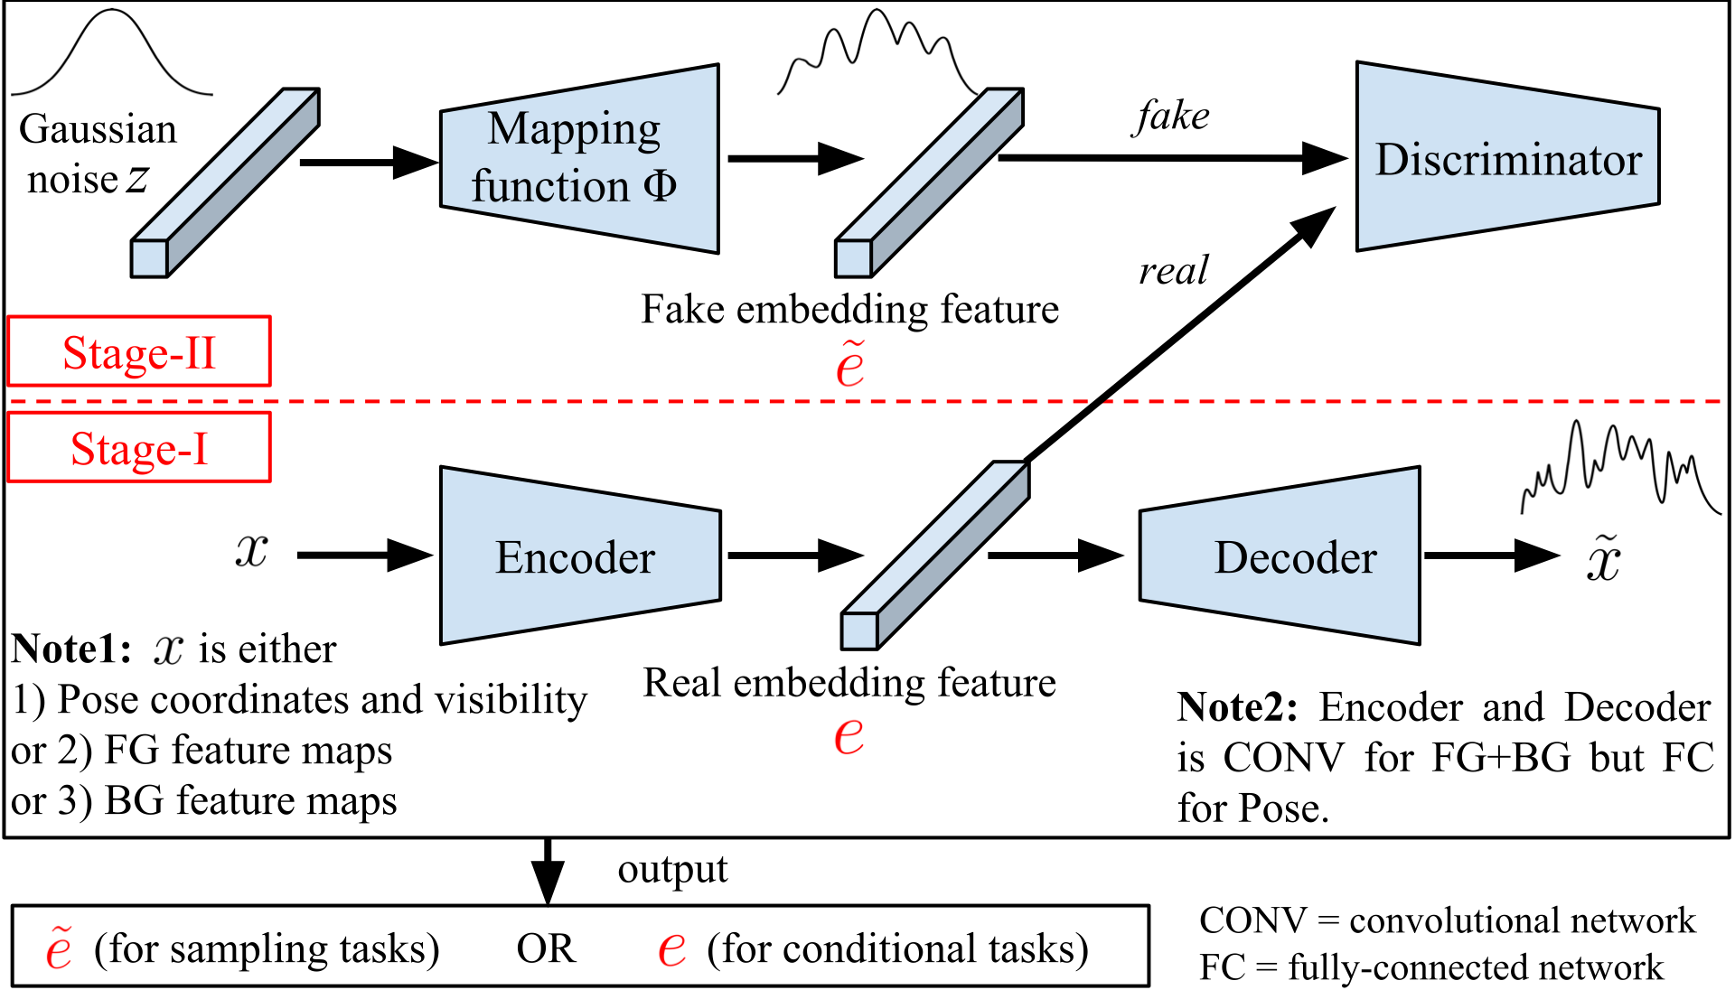
Framework
-- Disentangled Person Image Generation
Notes:
We propose a two-stage framework. The first stage is to disentangle the image into three kinds of embedding feature with a reconstruction pipeline. The three factors are foreground, background, and pose. Then, in stage II, we fix the Encoder and Decoder trained in stage I. And train the mapping functions to map the gaussian space to the embedding feature space. So that we can sample features from gaussian noise and then decode them to images.

Slide 5
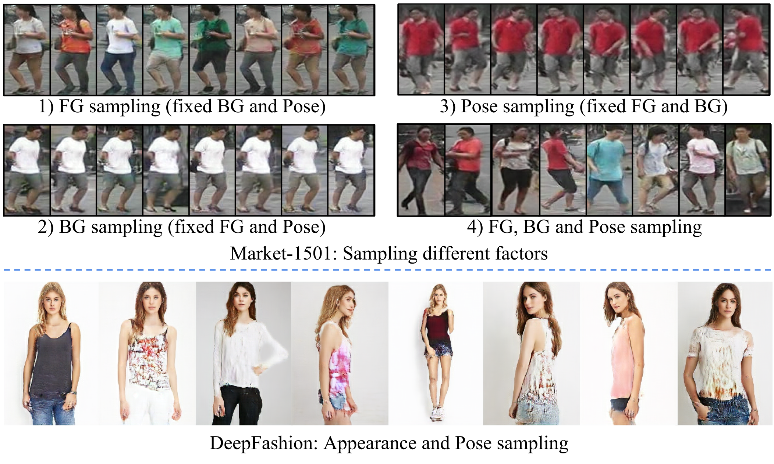
Experiments – sampling
-- Disentangled Person Image Generation
Notes:
Now let’s see some results. For the results on Market-1501 dataset, our model samples the foreground, background, pose separately or combined. Then, on high resolution deepfashion dataset, we can sample novel cloth style from the noise.

Slide 6
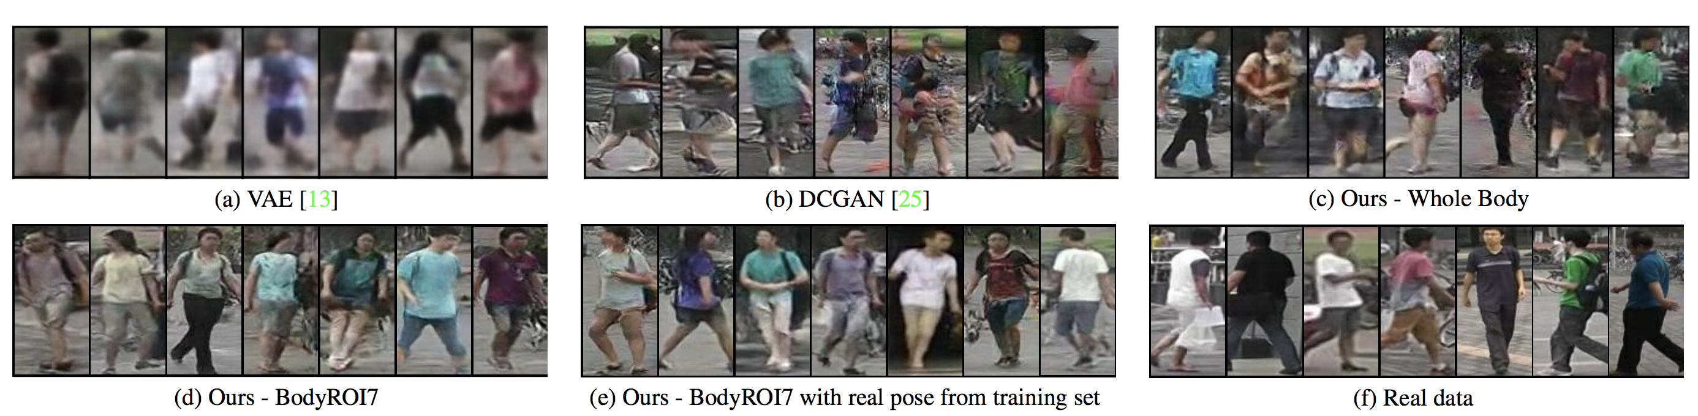
Experiments – sampling
-- Disentangled Person Image Generation
VAE
DCGAN
Ours
Real data
Sampling results comparison.
Our method can generate more realistic natural person images
Notes:
Compared to vanilla VAE and DCGAN model, Our method can generate more realistic natural person images

Slide 7
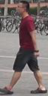
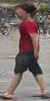
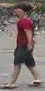
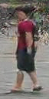
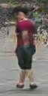
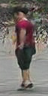
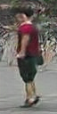
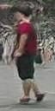
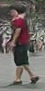
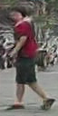
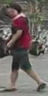
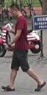
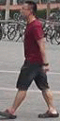
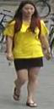
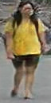
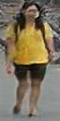
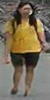
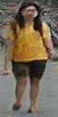
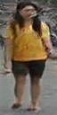
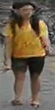
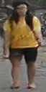
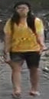
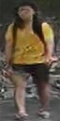
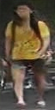
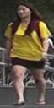
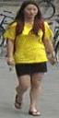
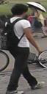
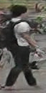
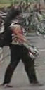
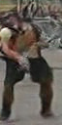
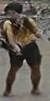
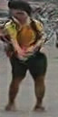
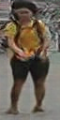
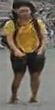
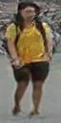
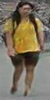


Experiments – interpolation
-- Disentangled Person Image Generation
Same person
x1
z1
z1+d
...
...
z1+(n-1)d
z2
x2
Same person
x1
z1
z1+d
...
...
z1+(n-1)d
z2
x2
Different persons
x1
z1
z1+d
...
...
z1+(n-1)d
z2
x2
Notes:
One more interesting experiment is the inverse interpolation. We first use gradient decent to find the corresponding Gaussian code z, and then do the linear interpolation in Gaussian space. We can both interpolate between two images of the same person or different persons.

Slide 8
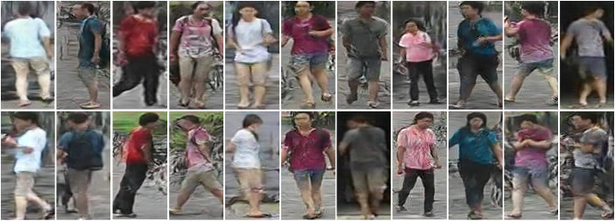
Experiments – person re-ID
-- Disentangled Person Image Generation
Our generated Virtual Market (VM) dataset
Model | Training data | Rank-1 | mAP
Res50 [1] | CUHK03 (labeled) | 0.300 | 0.115
Res50 [1] | Duke (labeled) | 0.361 | 0.142
Res50 | VM | 0.338 | 0.134
Res50+PUL | VM+Market | 0.369 | 0.156
Res50+PUL+KISSME | VM+Market | 0.375 | 0.154
Our generated data can benefit unsupervised re-ID
[1] H. Fan et al. Unsupervised Person Re-identification: Clustering and Fine-tuning. In Arxiv, 2017.
Notes:
Further more, we can control the three disentangled factors and generate a virtual market dataset. We fix the foreground factor and sample the background and pose to generate the different images of the same person.
The generated virtual dataset can benefit the unsupervised re-ID.

Slide 9
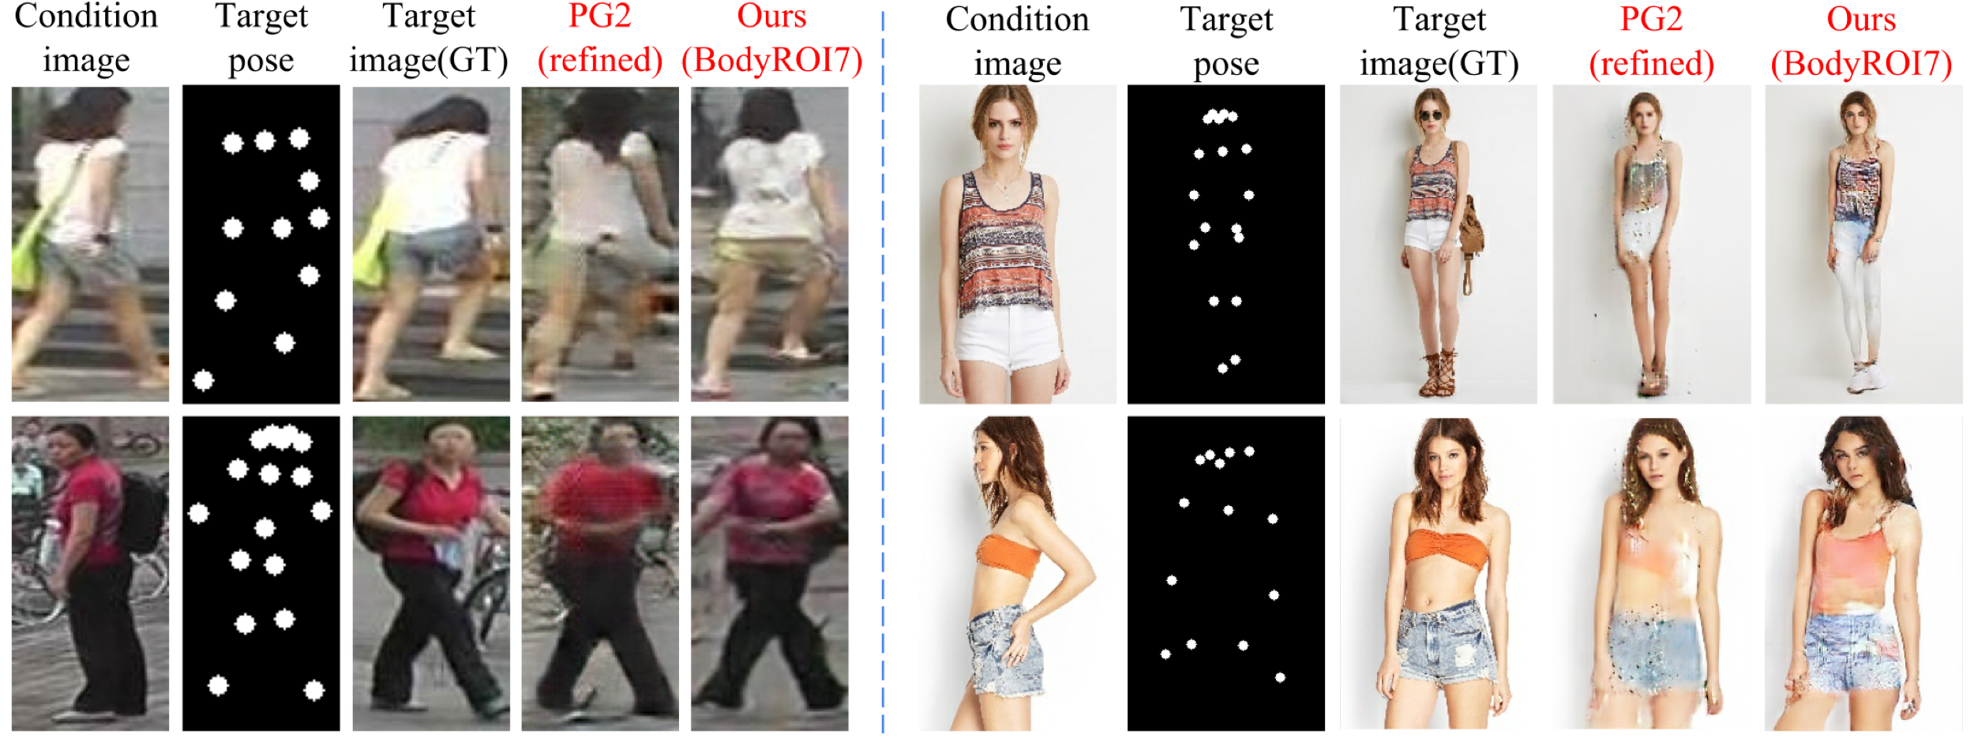
Experiments – human pose transfer
-- Disentangled Person Image Generation
[1]
[1]
Model | DeepFashion |  | Market-1501
 | SSIM | IS | SSIM | IS | Mask-SSIM | Mask-IS
PG2[1] | 0.762 | 3.090 | 0.253 | 3.460 | 0.792 | 3.435
Ours | 0.614 | 3.228 | 0.099 | 3.483 | 0.614 | 3.491
[1] L. Ma et al. Pose guided person image generation. In NIPS, 2017.
Notes:
As to the human pose transfer, namely generate person image conditioned on the input image and target pose.
Our method can achieve comparable performance, compared to the supervised method PG2.

Slide 10
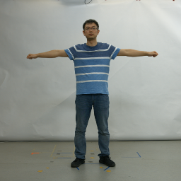
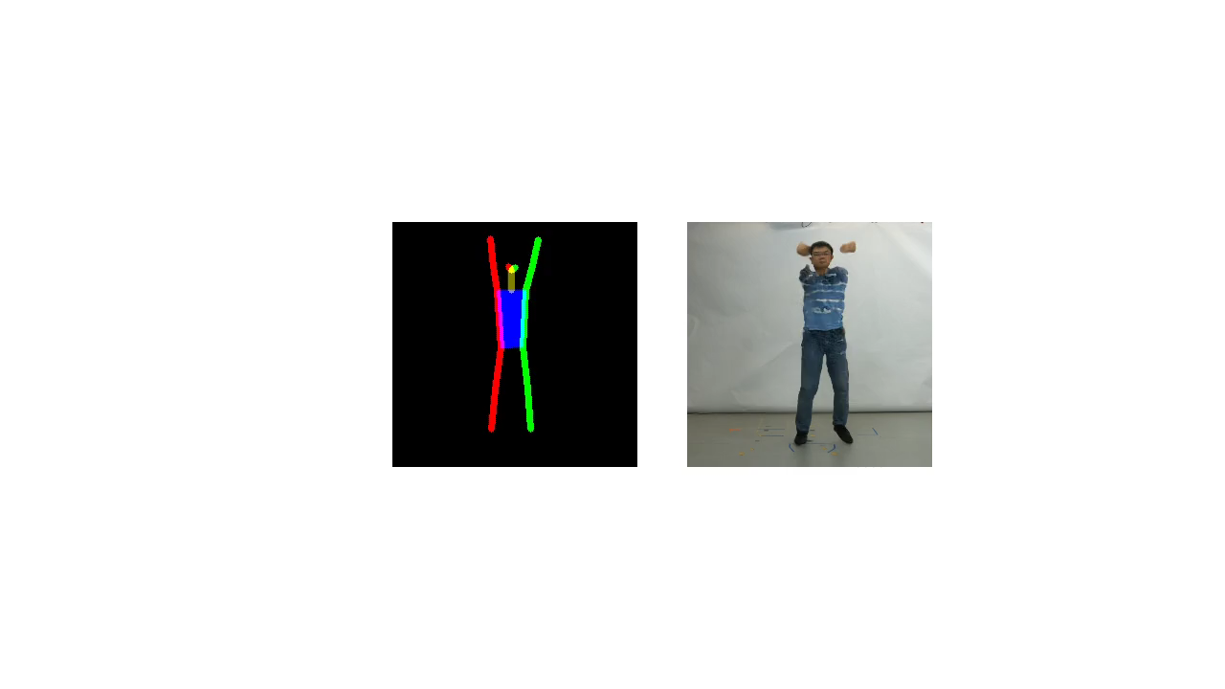




Experiments – human pose transfer
-- Disentangled Person Image Generation
Person A
Person B’s pose
Result
^{Paper ID: 1801}
^{Time: 10:10-12:30}
^{Place: Halls C-E}
Person B
Person A’s pose
Result
Project page
Notes:
Our method can also be used for video generation, given a sequence of target pose.
Here, we show the results of cross person pose transfer, that is use person B’s pose to drive person A’s appearance. And vice versa.
If you are interested in our work, please come to our poster. Thank you.

